Slide 1

EcoFOCI Seminar Series
Ecosystems and Fisheries Oceanography Coordinated Investigations
a National Oceanic and Atmospheric Administration joint research program between NOAA Research & NOAA Fisheries
Spring 2018 | LT Daniel Langis
Notes:
Thank you for joining us today for the EcoFOCI Seminar Series, presented at NOAA’s Pacific Marine Environmental Lab in Seattle, WA.
Please make sure to use your full name and email. To edit this information, right-click your name in the attendee list in GoToMeeting's control panel. And don’t forget to mute your microphone. Should you have questions throughout the presentation, please feel free to type them in the Chat at any time. We will address questions at the end of the talk. Following the seminar, any questions or requests should be directed to heather.tabisola@noaa.gov.
You can add the EcoFOCI Seminar Series Google Calendar by visiting both https://www.ecofoci.noaa.gov/events-calendar and the OneNOAA Sciecne Seminar list (https://www.nodc.noaa.gov/seminars/). Seminars are held weekly in the Fall and the Spring. Please email heather.tabisola@noaa.gov to join the mailing list.
Again, Thank You for joining us today. We will begin shortly.

Slide 2
ITAE Assets Slide

Slide 3


Acknowledgements
Funding for ITAE is provided by NOAA Research and the Pacific Marine Environmental Laboratory with in-kind support for the pop-up floats from Ecosystems and Fisheries-Oceanography Coordinated Investigations (NOAA/PMEL).
ITAE is a collaborative research effort by University of Washington (JISAO) and NOAA engineers and scientists at the Pacific Marine Environmental Lab (PMEL).
Special thanks to Phyllis Stabeno, Calvin Mordy, Chris Meinig, EDD, and all others who helped contribute to this project.

Slide 4
Outline
What are Pop-Up Buoys and why do we need them?
Gen 1 - Satellite Tag Prototype and Results (2015)
Gen 2 - In-House Development and Results (2016-2018)
Gen 3 - On-going Developments and Challenges (2018 and beyond)

Slide 5
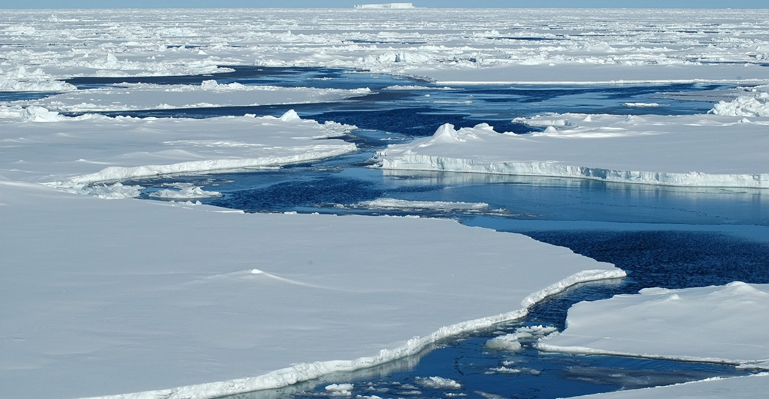
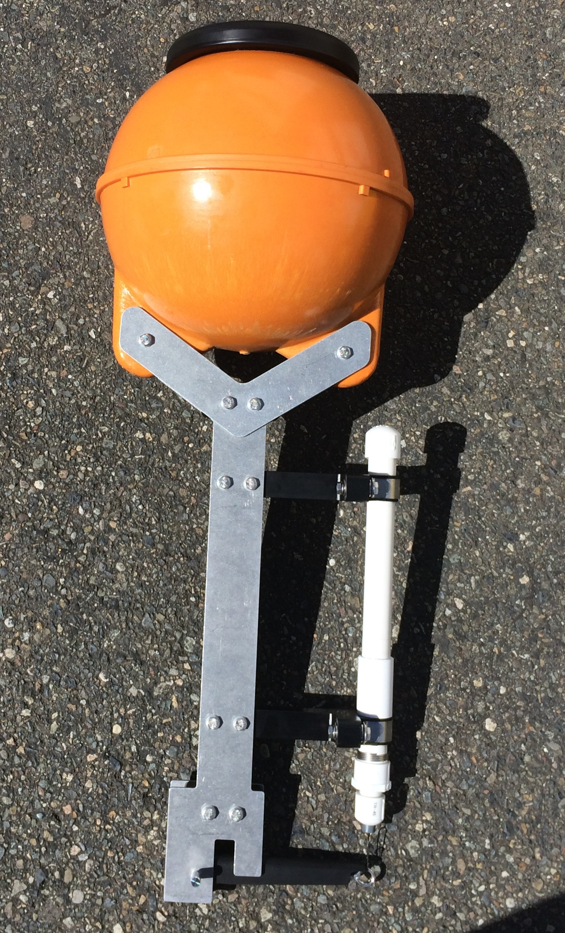
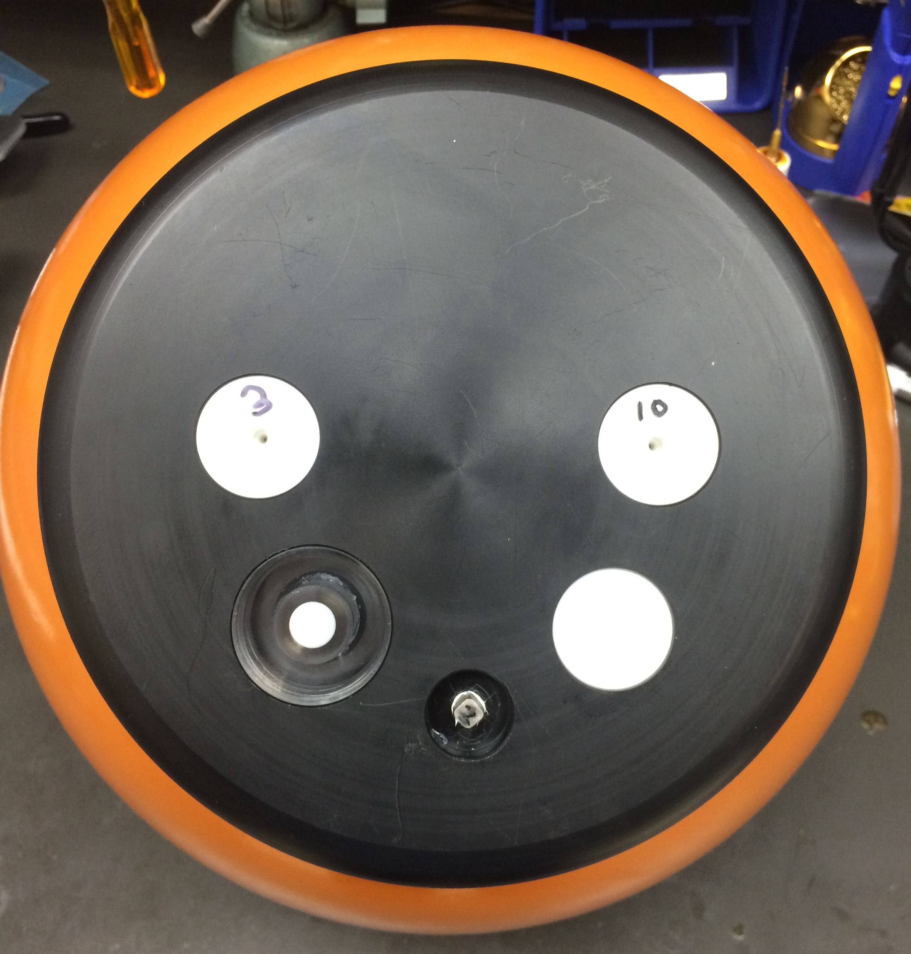
What is a Pop-Up Buoy?
Expendable under-ice buoy
Temperature, Depth, PAR, Tilt, GPS, Iridium (Gen 2)
Fluorometer, Camera (Gen 3)
Deployed in ice-free season
Moored on bottom during Winter
Releases in Spring and collects vertical profile
Collects data directly under ice until in open water
Approx. $2,000 per buoy ($3,500 with fluorometer)

Slide 6
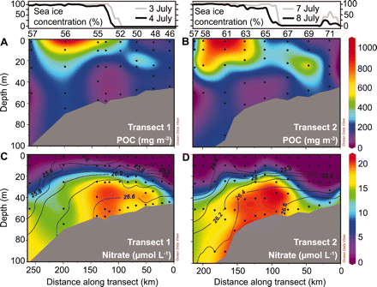
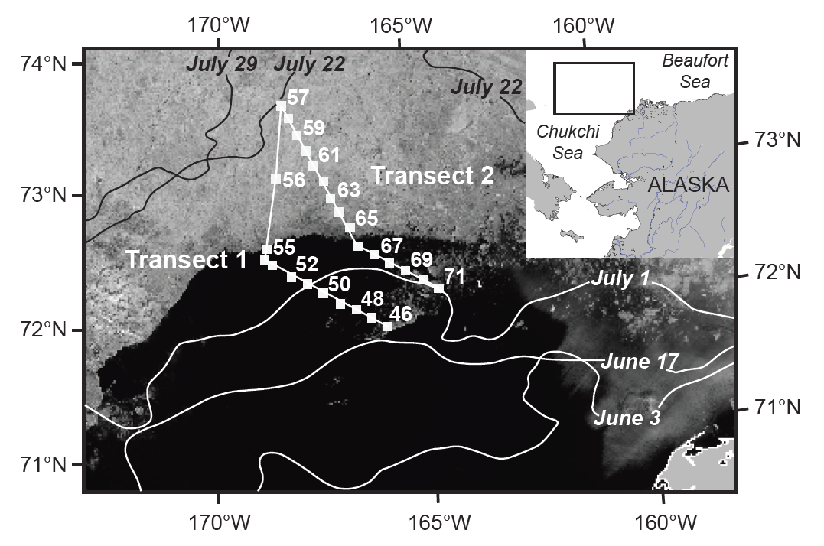
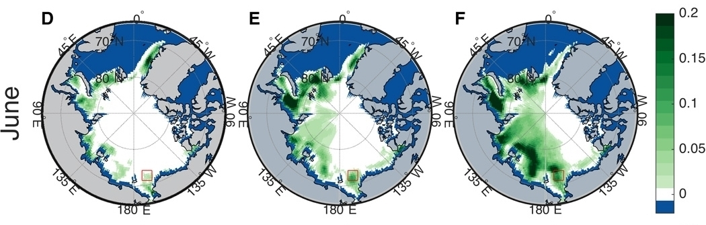
Why do we need under ice measurements?
1986-1995
1996-2005
2006-2015
2011 ICESCAPE – USCGC HEALY
“Although the impact of widespread phytoplankton blooms under sea ice on Arctic Ocean ecology and carbon fixation is potentially marked, the prevalence of these events in the modern Arctic and in the recent past is, to date, unknown”
“Our model results indicate that the recent thinning of Arctic sea ice is the main cause of a marked increase in the prevalence of light conditions conducive to sub-ice blooms. We find that as little as 20 years ago, the conditions required for sub-ice blooms may have been uncommon, but their frequency has increased to the point that nearly 30% of the ice-covered Arctic Ocean in July permits sub-ice blooms”
(Horvat et al, 2017)
“massive phytoplankton bloom beneath fully consolidated pack ice far from the ice edge in the Chukchi Sea, where light transmission has increased in recent decades because of thinning ice cover and proliferation of melt ponds”
“annual primary production in these waters may be underestimated by up to 10-fold”
(Arrigo et al, 2012)

Slide 7
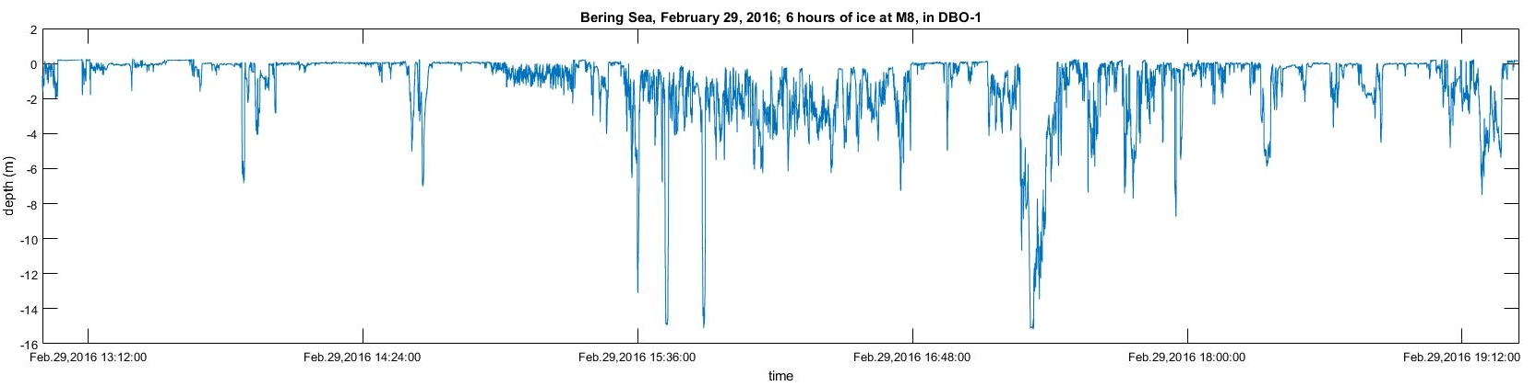
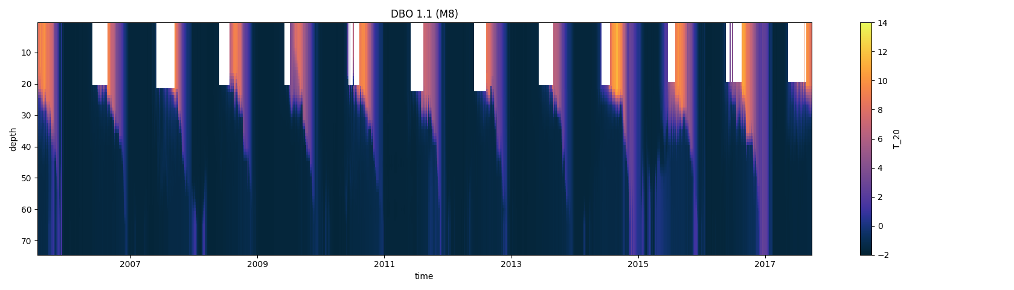
Large ice keels, constantly shifting floes, and broad inaccessibility make data collection under sea ice notoriously difficult. Other forms of technology cannot access the under ice regime or are prohibitively expensive.
Ice Profiler Data
courtesy of
Peggy Sullivan

Slide 8
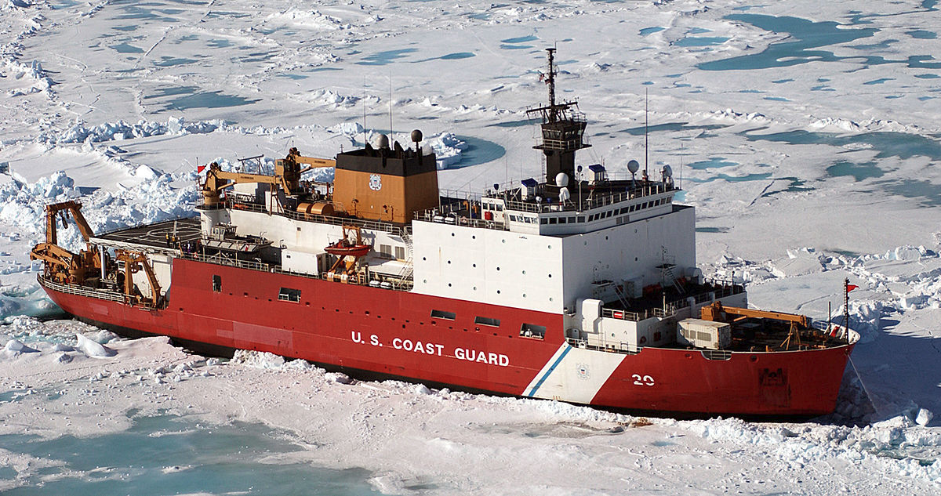
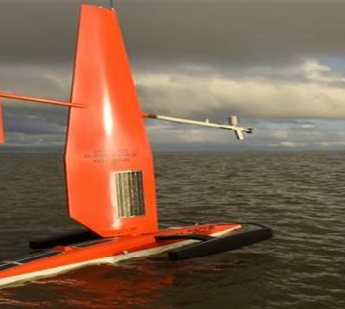
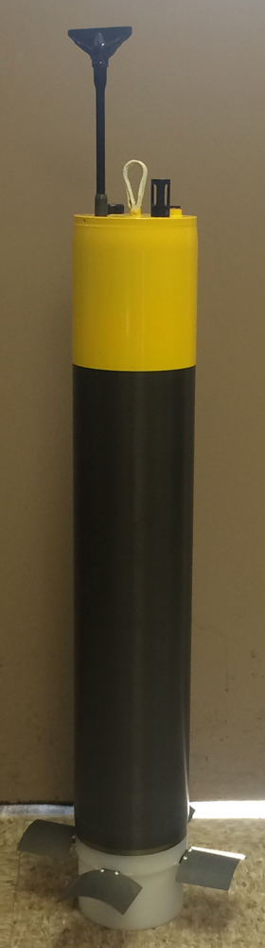
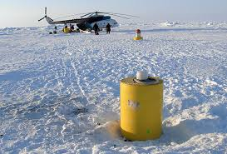
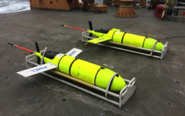
Large ice keels, constantly shifting floes, and broad inaccessibility make data collection under sea ice notoriously difficult. Other forms of technology cannot access the under ice regime or are prohibitively expensive.

Slide 9
What are the functional requirements for an under ice buoy to be successful?
Highly Robust
Low-cost and/or recoverable data (risk of instrument loss)
Must access regime directly under ice
Must provide high quality data

Slide 10
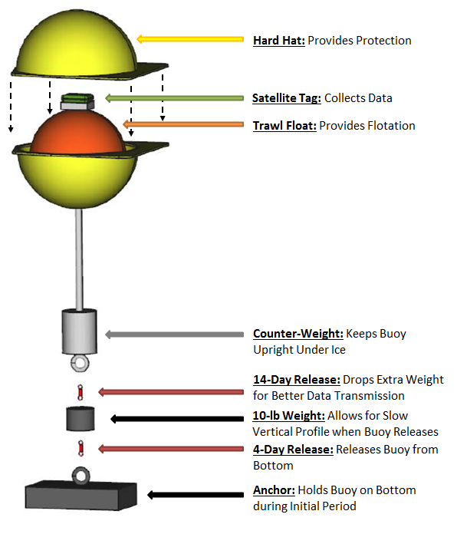
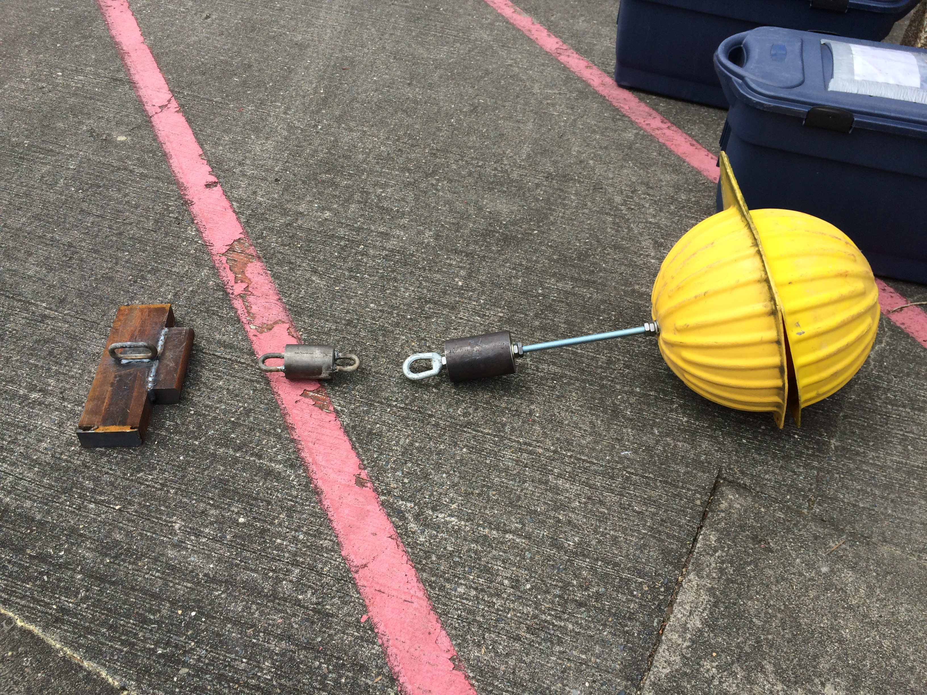
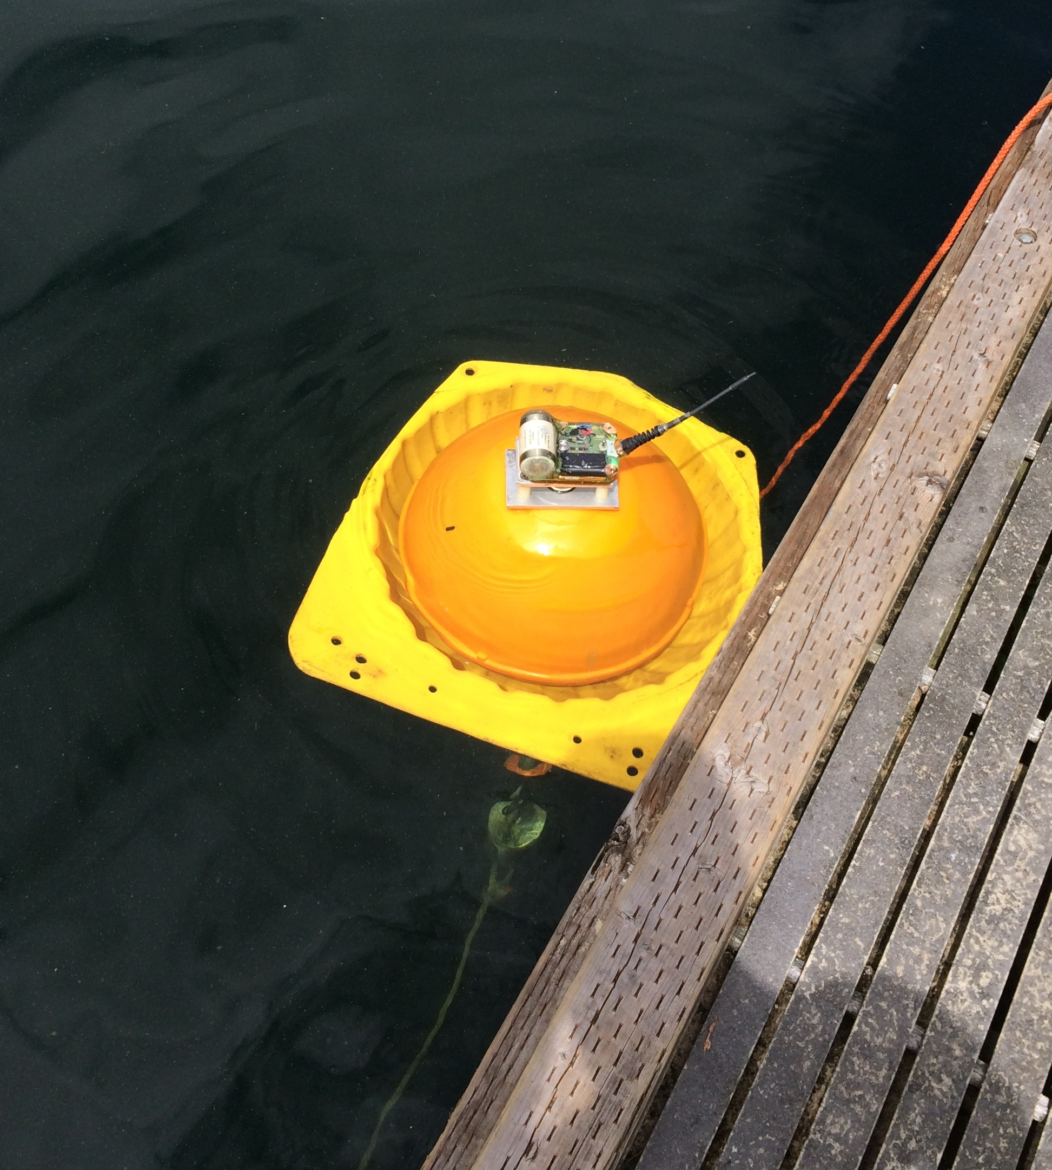
The quickest method of testing an under-ice pop-up buoy was to make a prototype using satellite tags.
Satellite Tags from Sea Mammal Research Unit at University of St. Andrews
Sensors: PAR, Temperature, Depth, Tilt, Wet/Dry

Slide 11
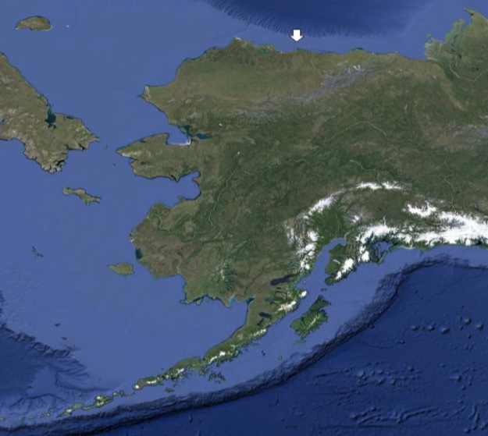
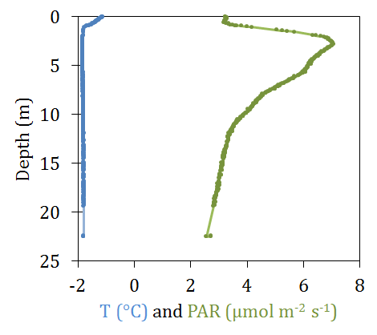
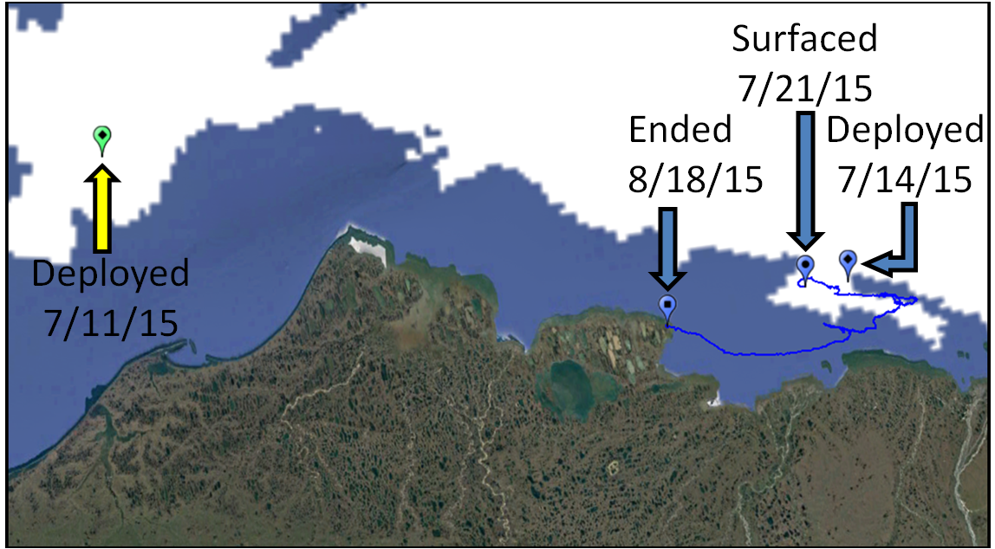
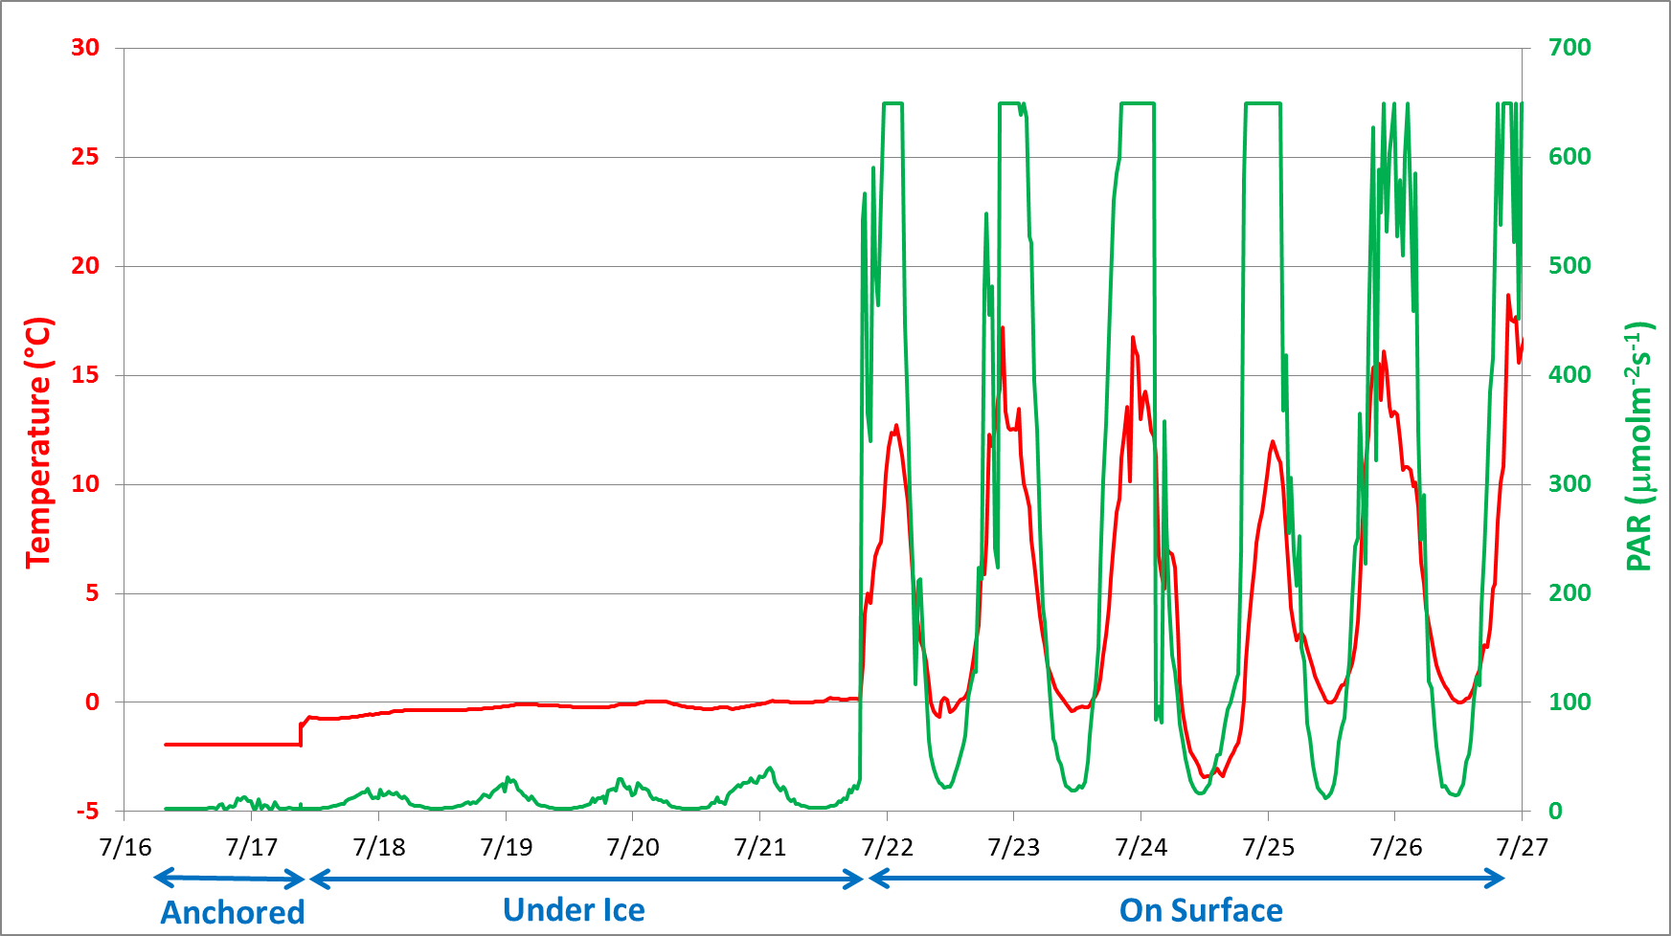
Two prototype buoys were deployed from the USCGC Healy in July 2015. One unit worked as expected.
Multisensor Analyzed Sea Ice Extent shown for 7/15/15
Notes:
2 Prototype buoys deployed from USCGC Healy in July 2015
One surfaced 1 week after deployment
One unit (thought to be lost) transmitted 13 months after deployment
MASIE shown for 7/15/15. (Deployments were on 7/11/17 and 7/15/17)

Slide 12
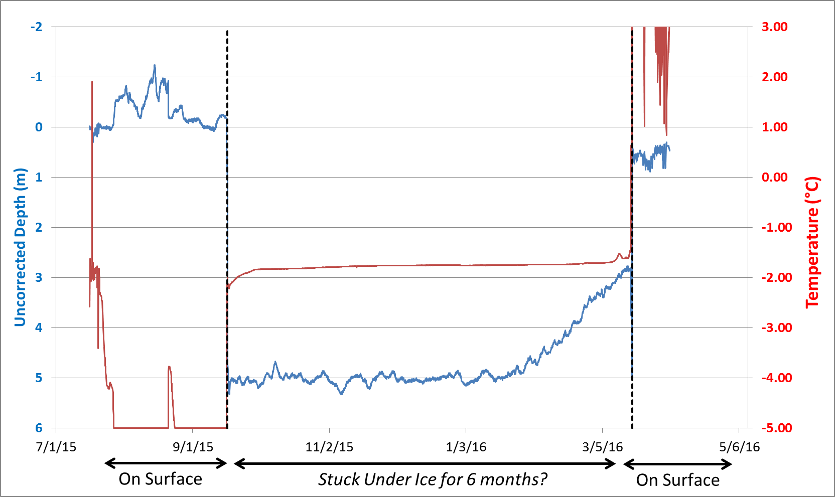
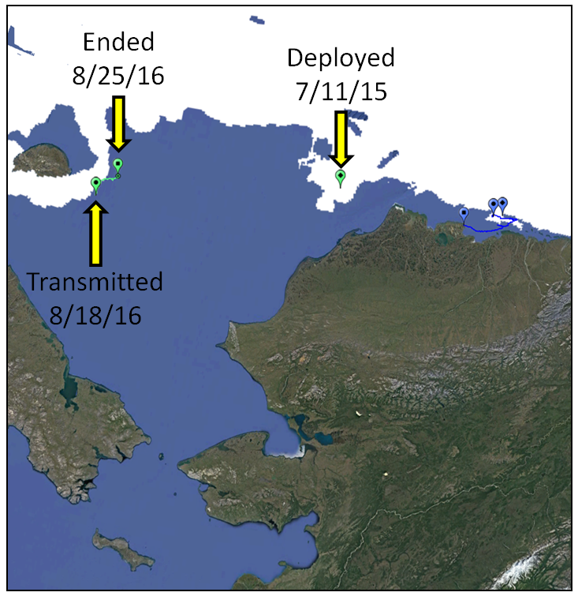
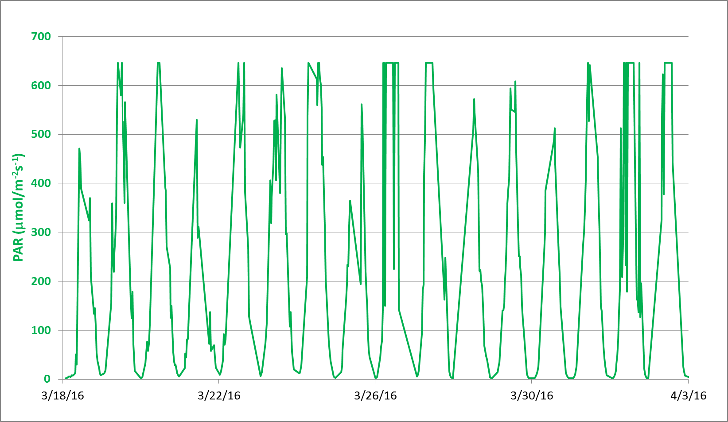
What about the second buoy?
Multisensor Analyzed Sea Ice Extent shown for 7/15/15
Notes:
Problems with Data
Depth goes from 0 to 5 m (indicating under ice) in mid-September when ice is at or near the minimum
Depth goes to 0 m (indicating at the surface) in mid-March when ice is at or near the maximum
Dates indicate unit surfaced in March 2016, but transmissions from Argo were not received until August 2016
Positive take aways
Buoys are robust (even with a less-robust design than current buoys) and can survive for long periods under ice
Satellite telemetered data can be successful

Slide 13

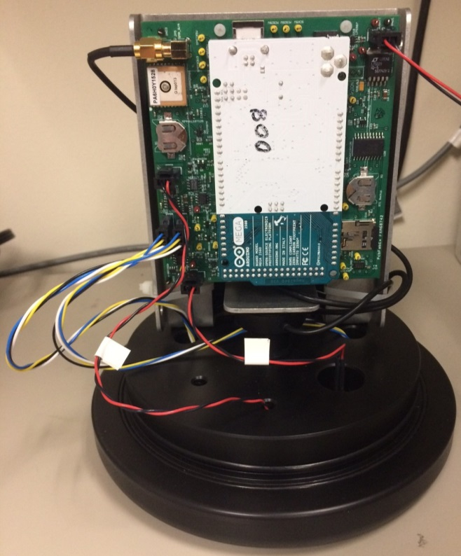
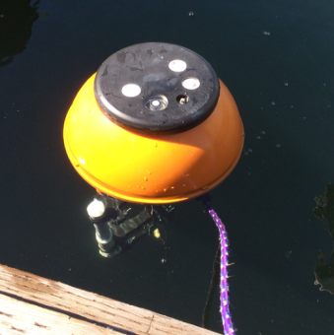
The prototype was successful, but lack of control over data quality, high costs, communication challenges, and lack of commercial alternatives drove us to develop an instrument in-house at PMEL.
Notes:
In order to reduce production costs for these expendable floats, they have been custom designed in‐house by PMEL. A number of novel cost‐saving design features have been integrated to achieve a cost per float of ~$2,000 ‐ such as low‐cost pressure housings, commercial off‐the‐shelf electronics and a load reducing mechanism to utilize burn wire releases. Despite cost‐reductions, the floats still provide high‐quality data, measuring temperature to ± 0.01°C accuracy, depth to ± 0.21m accuracy, and PAR to ± 3% accuracy, as well as tilt angle and GPS location. They transmit data to shore using an on‐board Iridium modem.

Slide 14
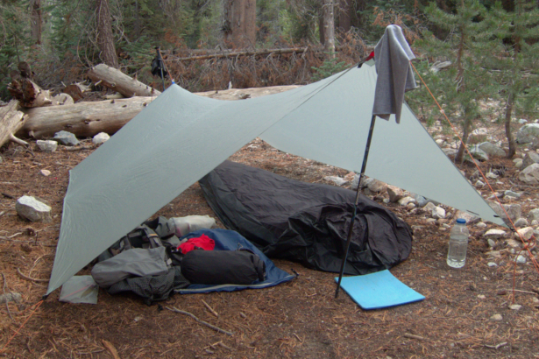
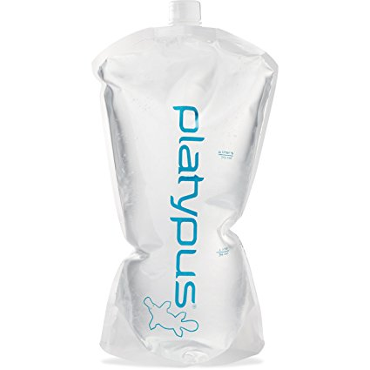
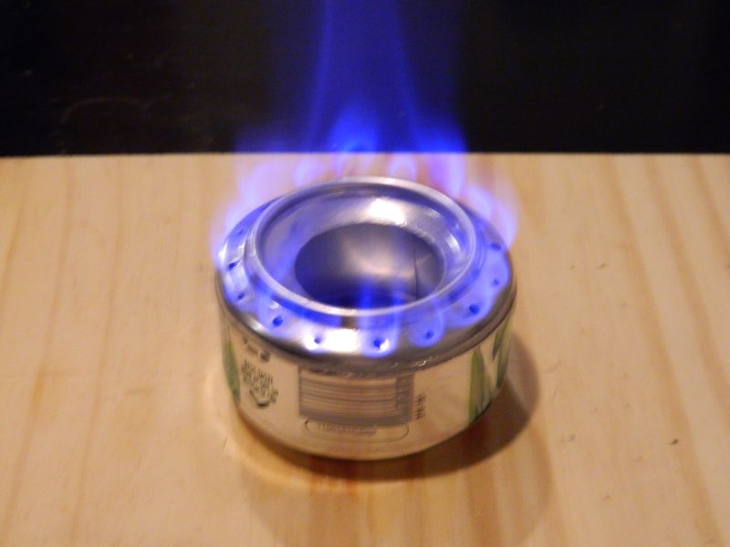
Reducing total costs means driving down costs at all levels of the instrument and closely aligning objectives with equipment capabilities and expected environmental conditions.
Andrew Skurka: “when I completed the 6,875-mile Great Western Loop in 7 months (33 miles per day pace), I carried lightweight gear and calorically dense food, and hiked efficiently by always taking care of my feet and avoiding navigational mistakes.
In contrast, when my wife and I hiked the 28-mile Aspen Four Pass Loop for our anniversary weekend, I carried a full-sized tent, her Kindle, and a powerful stove for coffee and a hot wash cloth at night. We moved well, but had more free-time for long breaks and swimming, and could hunker down in our shelter to avoid afternoon thunderstorms.”
https://andrewskurka.com/2017/beginner-first-time-backpackers-advice-info-tips-resources/
“A tarp & bivy offers full — albeit barebones — protection against precip, insects, groundwater, and wind. It’s an ultralight and compact package that will be too minimalist for most.”
https://andrewskurka.com/2016/gear-list-backpacking-tarp-bivy-ultralight-minimalism/
Notes:
In order to reduce production costs for these expendable floats, they have been custom designed in‐house by PMEL. A number of novel cost‐saving design features have been integrated to achieve a cost per float of ~$2,000 ‐ such as low‐cost pressure housings, commercial off‐the‐shelf electronics and a load reducing mechanism to utilize burn wire releases. Despite cost‐reductions, the floats still provide high‐quality data, measuring temperature to ± 0.01°C accuracy, depth to ± 0.21m accuracy, and PAR to ± 3% accuracy, as well as tilt angle and GPS location. They transmit data to shore using an on‐board Iridium modem.

Slide 15
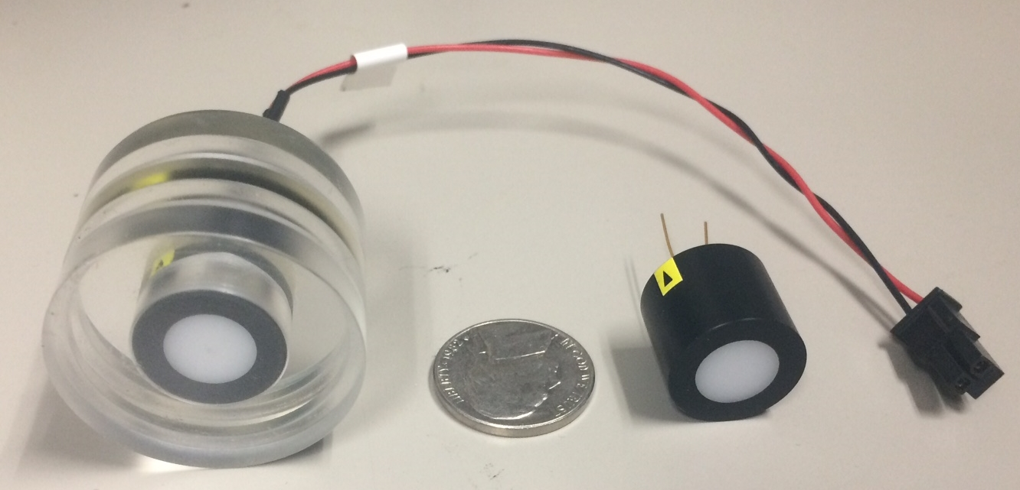
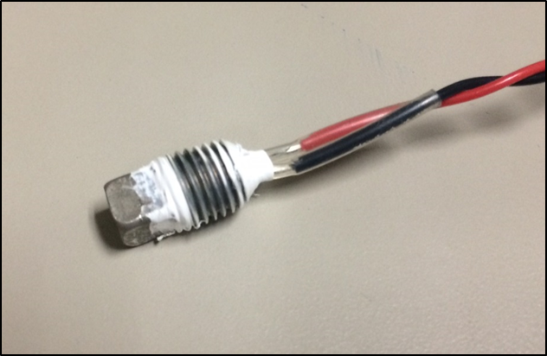
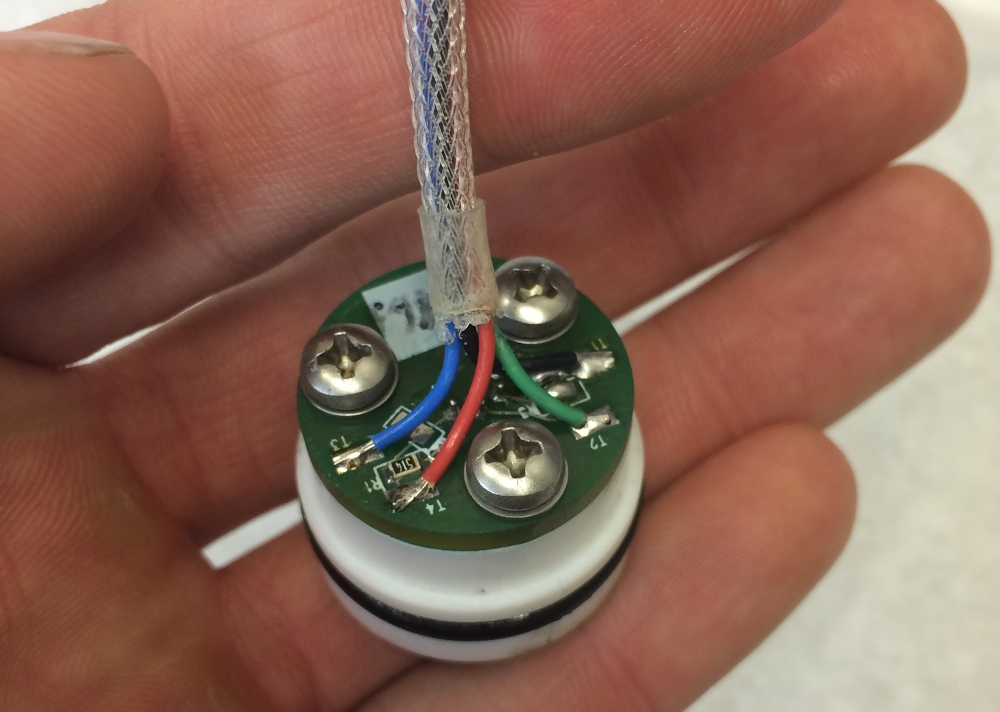
How do we drive down cost at all levels?
PAR
Sensor:
Skye Instruments
TAG-PARQ
Range:
0 to 2000 μmol/m²s
Absolute Accuracy:
±3% or better
Resolution:
0.068 mmol/m²s
Cost:
$280
Temperature
Sensor:
Custom Built
NTC Thermistor Probe
Range:
-5°C to +70°C
Absolute Accuracy:
±0.01°C or better
Resolution:
0.0006°C (at 0°C)
Cost:
$10
Pressure
Sensor:
Keller PA-4LD (x2)
(Same as Prawler)
Range:
0 to 30m / 0 to 100m
Absolute Accuracy (at 0°C):
4.5 cm / 15.0 cm
Resolution:
0.1 cm / 0.3 cm
Cost:
$133 / $118
Notes:
In order to reduce production costs for these expendable floats, they have been custom designed in‐house by PMEL. A number of novel cost‐saving design features have been integrated to achieve a cost per float of ~$2,000 ‐ such as low‐cost pressure housings, commercial off‐the‐shelf electronics and a load reducing mechanism to utilize burn wire releases. Despite cost‐reductions, the floats still provide high‐quality data, measuring temperature to ± 0.01°C accuracy, depth to ± 0.21m accuracy, and PAR to ± 3% accuracy, as well as tilt angle and GPS location. They transmit data to shore using an on‐board Iridium modem.

Slide 16
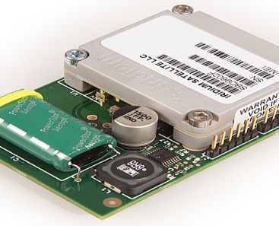
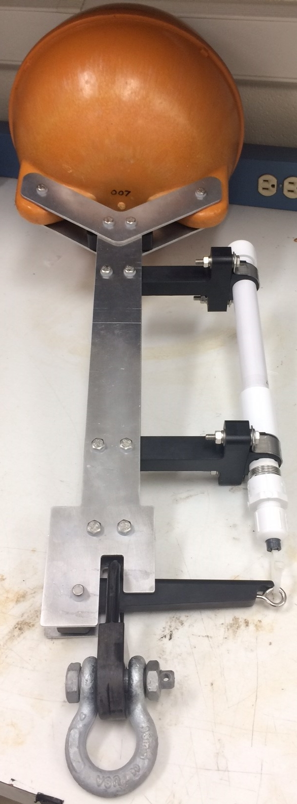
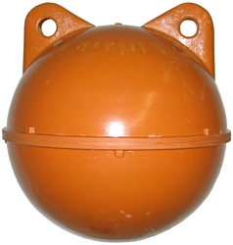
How do we drive down cost at all levels?
Pressure Housing
Unit:
12” Trawl Float
Highlights:
800m Depth Rating
27.5 lb buoyancy
Machinable
Cost:
~$30
Iridium Module
Unit:
RockSeven RockBLOCK Mk2
Highlights :
Two-Way Communication IridiumSBD Software Library
Simple 5 wire connection
Cost:
$249 + $85 Antenna
Burn Wire Release
Unit:
Sub-Sea Sonics
TR-45 Timed Release
Highlights:
40 lb Maximum Load
170 Day Maximum
Cost:
$165
Notes:
In order to reduce production costs for these expendable floats, they have been custom designed in‐house by PMEL. A number of novel cost‐saving design features have been integrated to achieve a cost per float of ~$2,000 ‐ such as low‐cost pressure housings, commercial off‐the‐shelf electronics and a load reducing mechanism to utilize burn wire releases. Despite cost‐reductions, the floats still provide high‐quality data, measuring temperature to ± 0.01°C accuracy, depth to ± 0.21m accuracy, and PAR to ± 3% accuracy, as well as tilt angle and GPS location. They transmit data to shore using an on‐board Iridium modem.

Slide 17
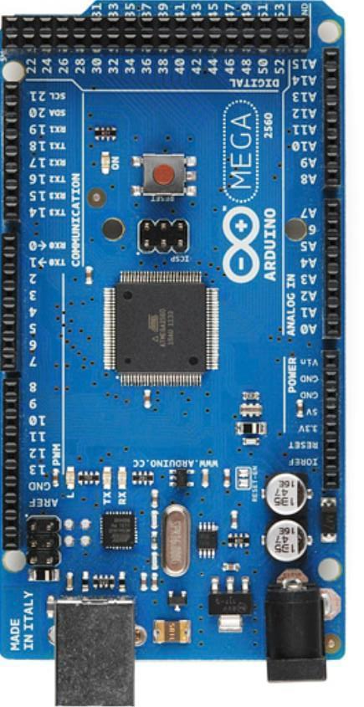
How do we drive down cost at all levels?
MicroController
Unit:
Arduino MEGA
Advantages:
Easy to program and integrate additional sensors/circuits
SPI, I²C, 4 Hardware Serial Ports
Rapid prototyping can significantly reduce development times
Open-source software libraries
Disadvantages:
Nominal current consumption ~60mA
More nuanced configuration for deployment
Open-source software libraries
Cost:
$38
Notes:
In order to reduce production costs for these expendable floats, they have been custom designed in‐house by PMEL. A number of novel cost‐saving design features have been integrated to achieve a cost per float of ~$2,000 ‐ such as low‐cost pressure housings, commercial off‐the‐shelf electronics and a load reducing mechanism to utilize burn wire releases. Despite cost‐reductions, the floats still provide high‐quality data, measuring temperature to ± 0.01°C accuracy, depth to ± 0.21m accuracy, and PAR to ± 3% accuracy, as well as tilt angle and GPS location. They transmit data to shore using an on‐board Iridium modem.

Slide 18
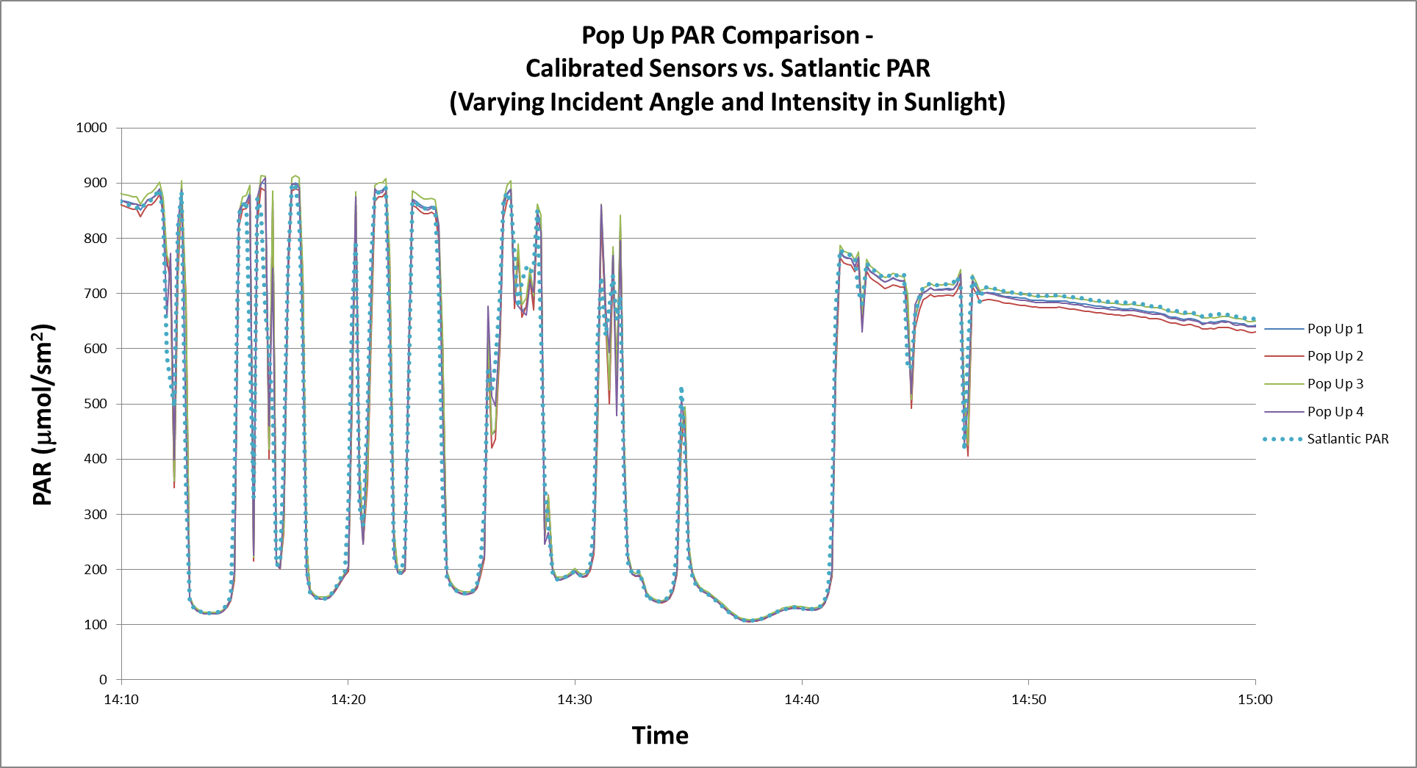
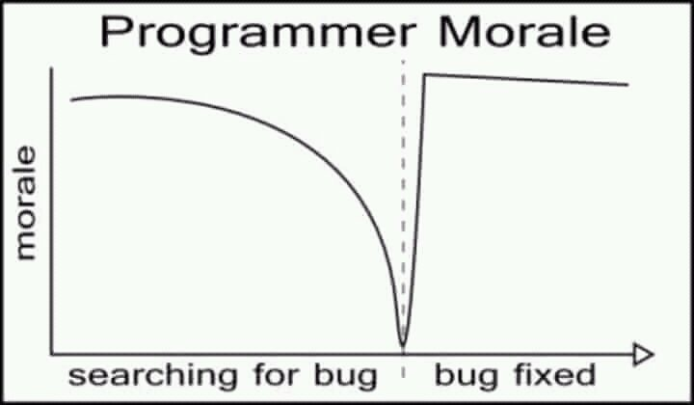
The 2016 deployment deadline was missed due to software library issues, but this allowed for more thorough testing in 2017.

Slide 19
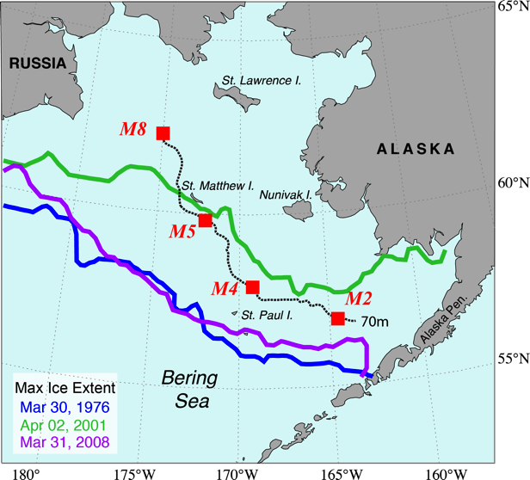
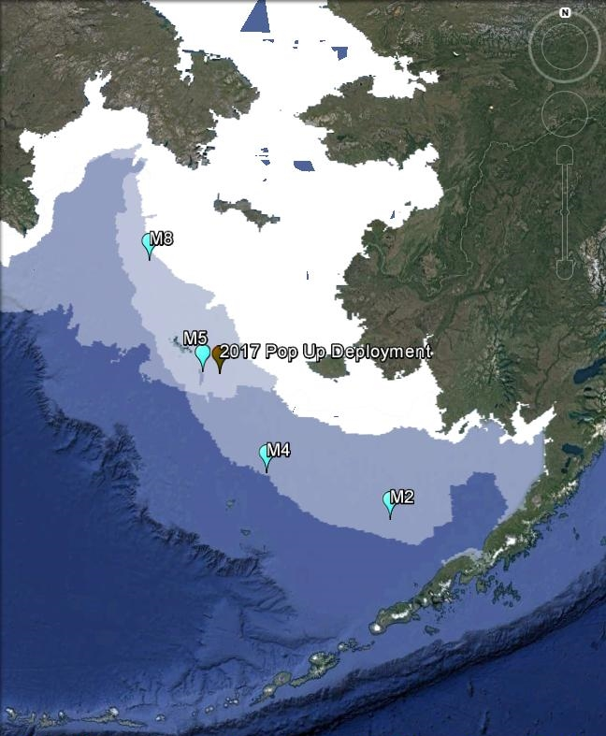
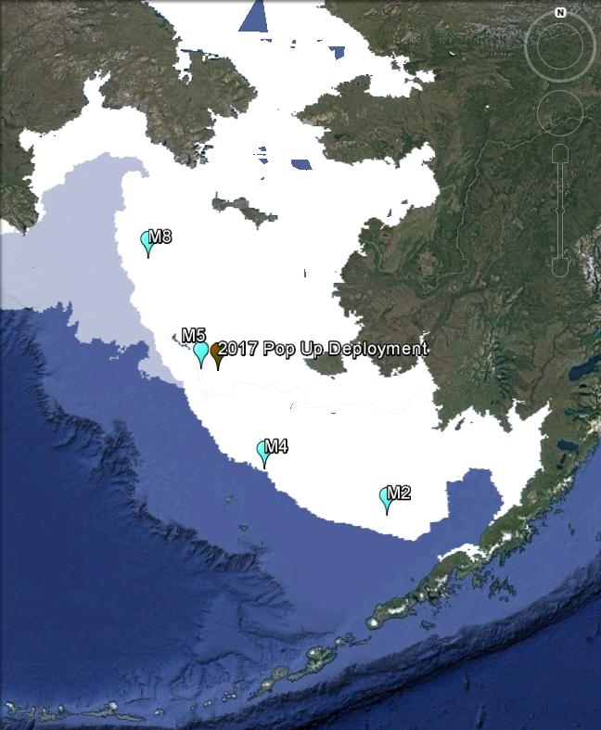
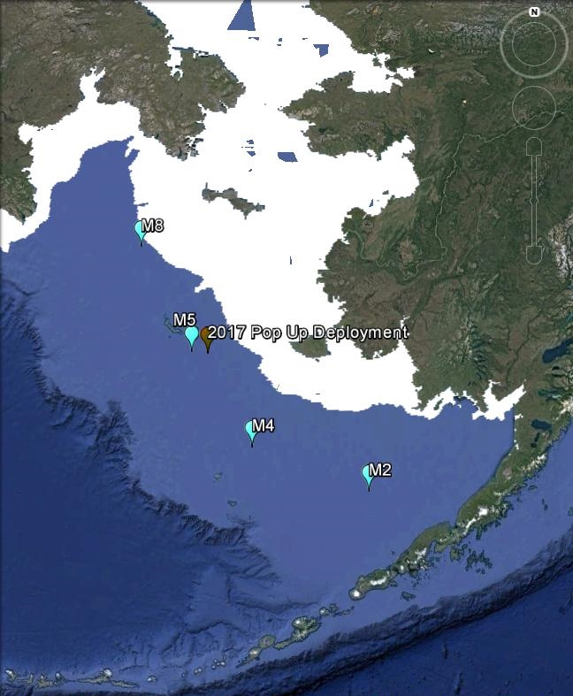
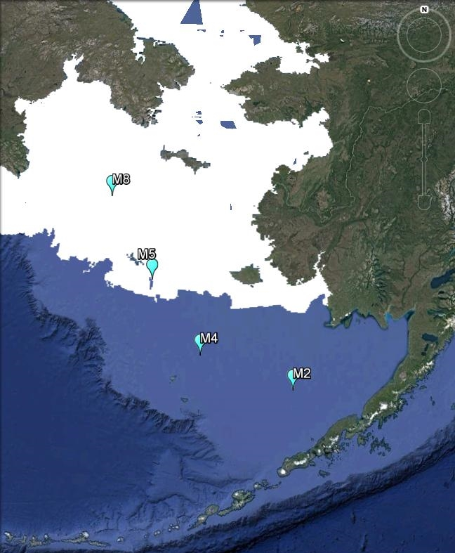
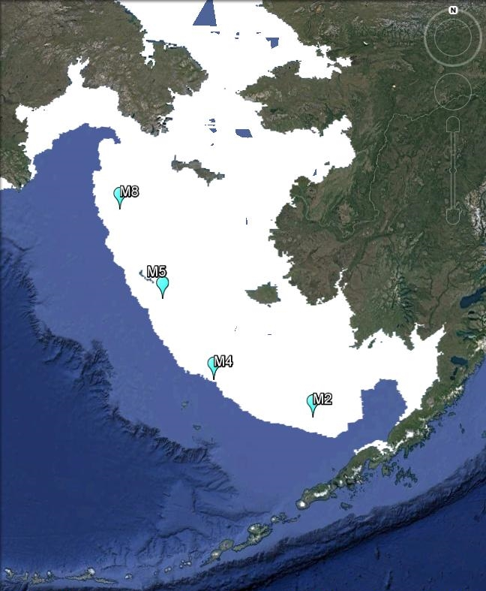
Five pop-up buoys were deployed in the Bering Sea in September 2017 with release dates in February/March 2018.
2016
2018
MASIE
Shown for March 17 of 2016, 2017,
and 2018
2017
Multisensor Analyzed Sea Ice Extent
Imagery courtesy of NASA NSIDC DAAC
ftp://sidads.colorado.edu/DATASETS/NOAA/G02186/kmz/
Notes:
5 Units Deployed on DY17-08
Deployed 9/27/17 approx. 20nm east of M5
Buoys released late Feb/early March 2018
Temp, PAR, Depth
Expectation that buoys would flow south and melt out relatively quickly due to currents and ice movement (Phyllis)
Ice flows will be tracked using satellite data to determine position while under ice
Lessons learned
Overall very successful
Data is good
Iridium SBD works well
Burn wire timing works well
Ideally need a temperature threshold and longer duration on release (No Ice in ‘17)

Slide 20
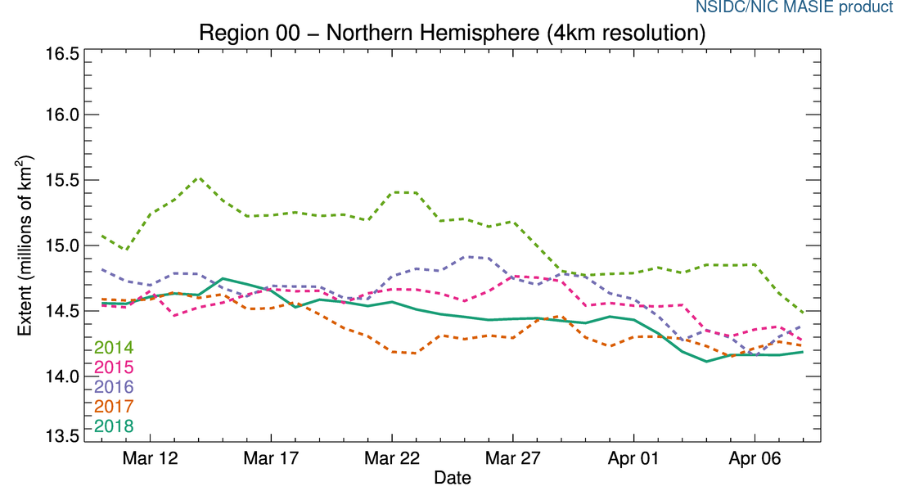
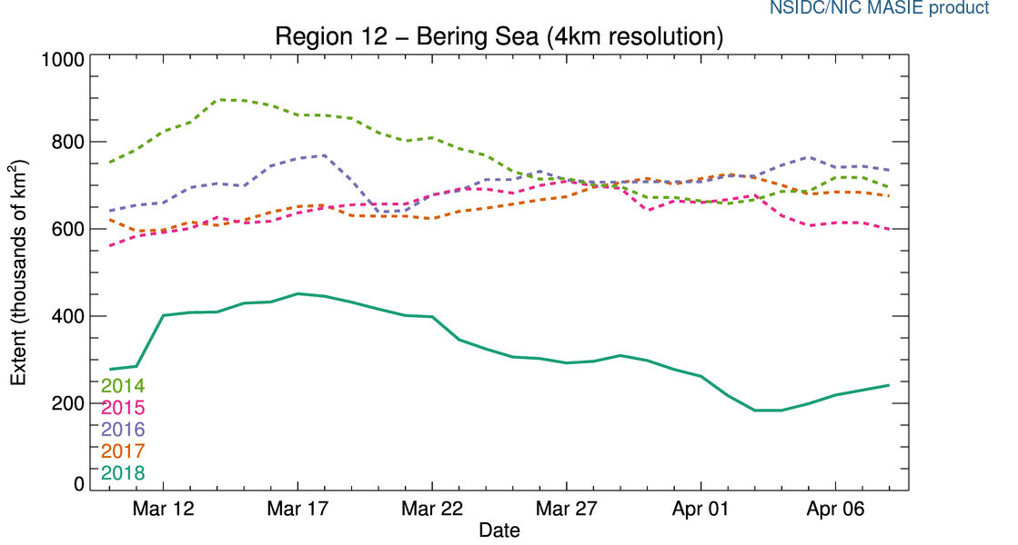
“The most notable aspect of the 2017 to 2018 winter ice extent was the persistently low ice extent in the Bering Sea.”
National Snow and Ice Data Center
Artic Sea Ice News & Analysis (April 4, 2018)
2016
2018
2017
Multisensor Analyzed Sea Ice Extent
Imagery courtesy of NASA NSIDC DAAC
ftp://sidads.colorado.edu/DATASETS/NOAA/G02186/kmz/
Notes:
“The most notable aspect of the 2017 to 2018 winter ice extent was the persistently low ice extent in the Bering Sea”
5 Units Deployed on DY17-08
Deployed 9/27/17 approx. 20nm east of M5
Buoys released late Feb/early March 2018
Temp, PAR, Depth
Expectation that buoys would flow south and melt out relatively quickly due to currents and ice movement (Phyllis)
Ice flows will be tracked using satellite data to determine position while under ice
Lessons learned
Overall very successful
Data is good
Iridium SBD works well
Burn wire timing works well
Ideally need a temperature threshold and longer duration on release (No Ice in ‘17)

Slide 21
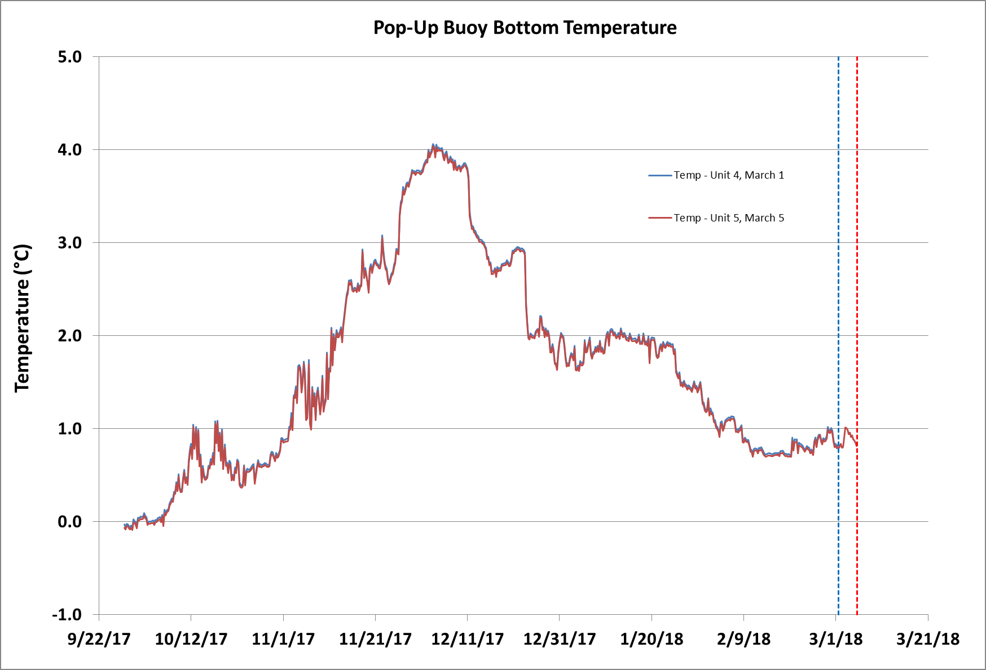
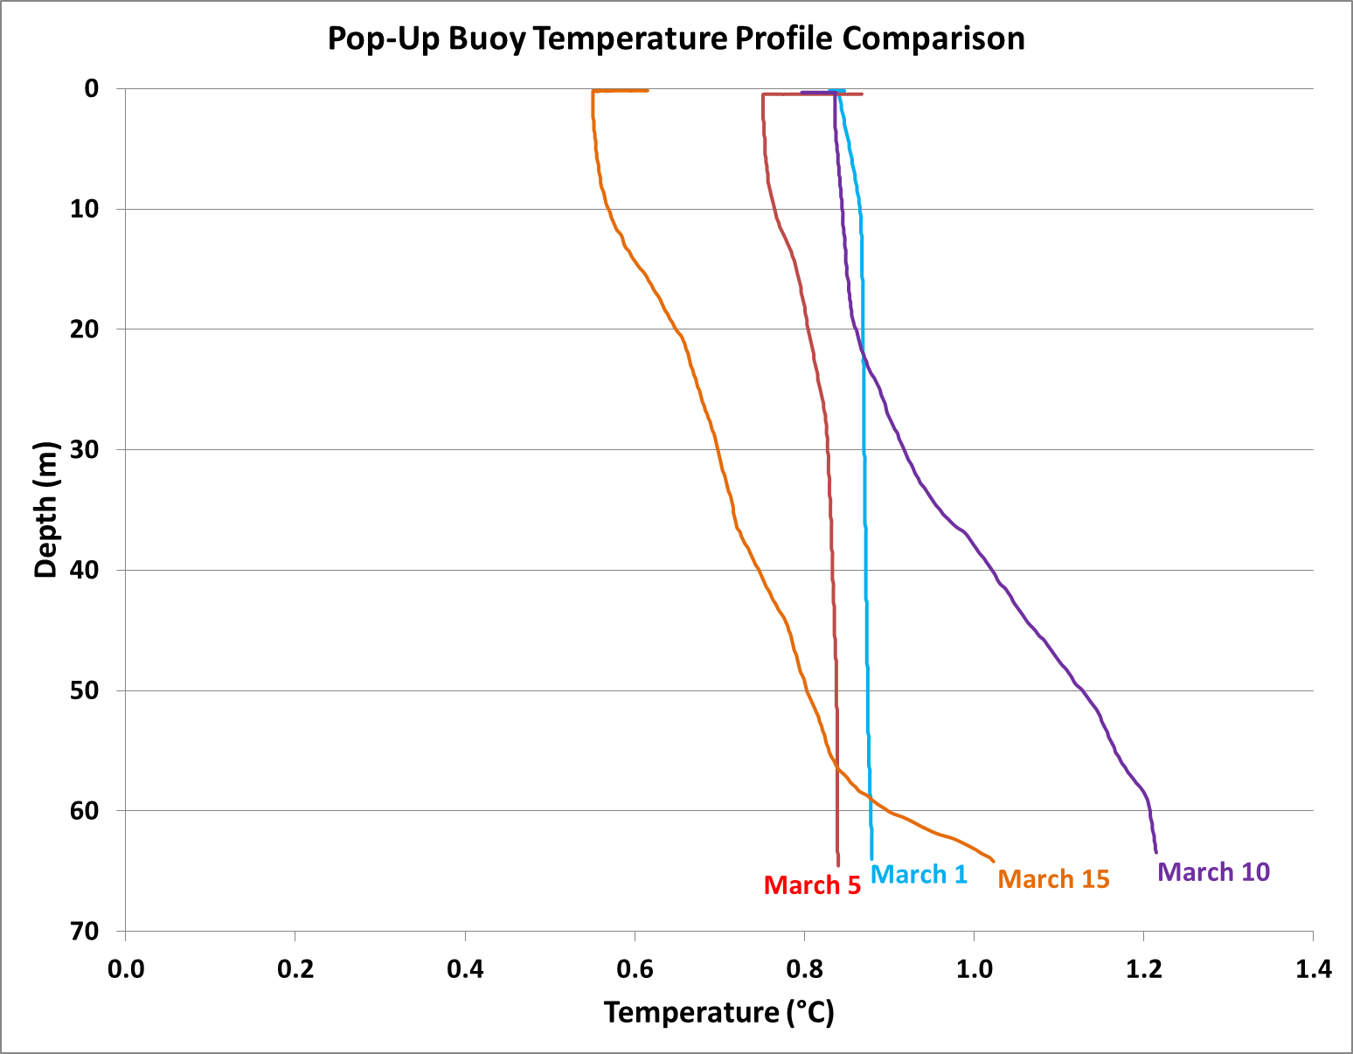
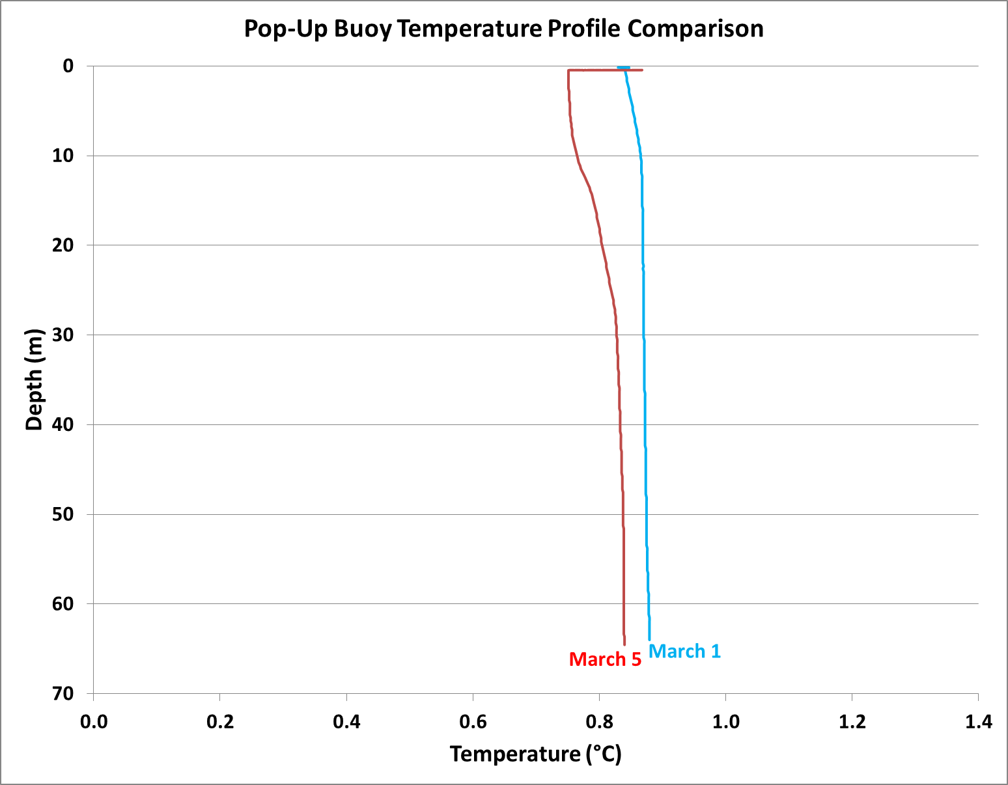
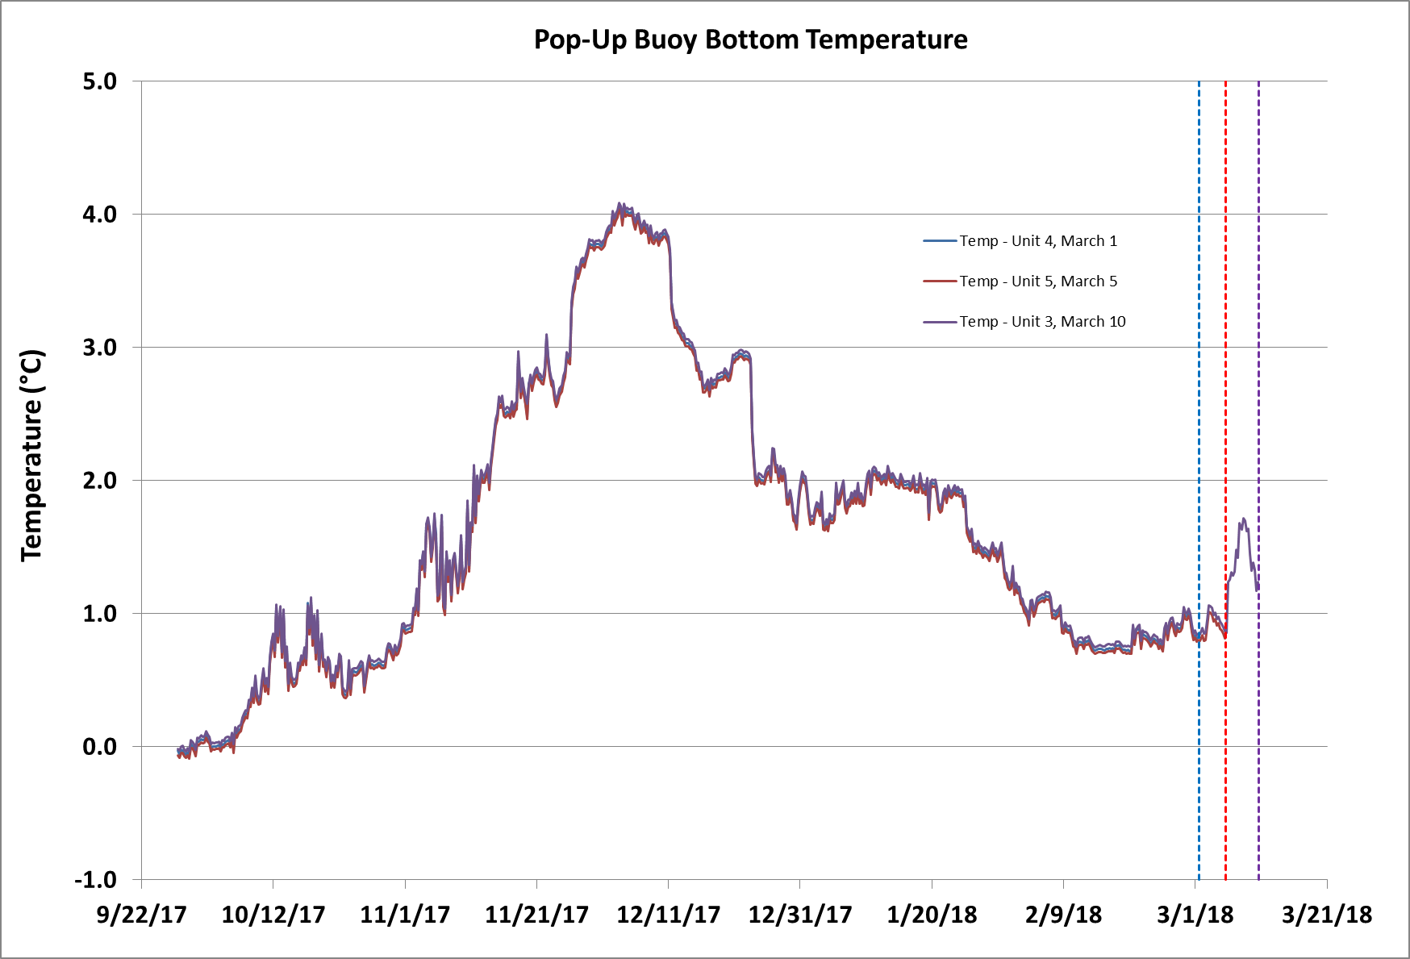
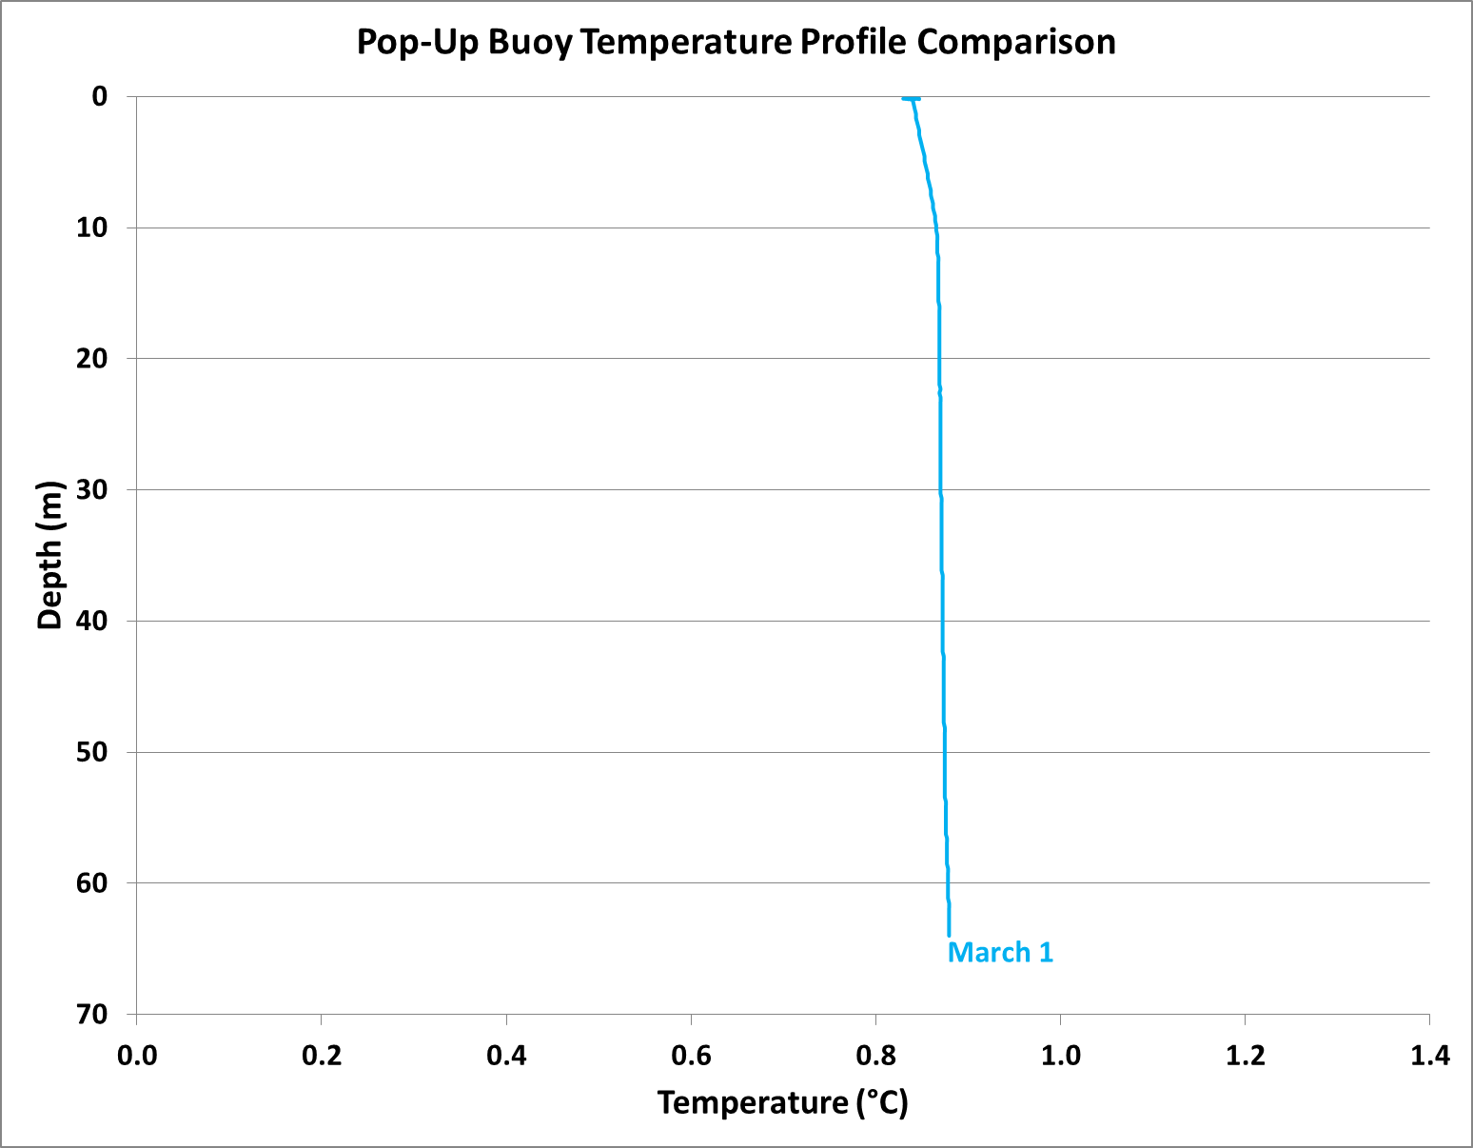



Ice extent never reached the 2017 deployment site, but 4 of 5 buoys surfaced in open water and provided quality data.
Release Dates: Feb 20, Mar 1, Mar 5, Mar 10, Mar 15

Slide 22


Ice extent never reached the 2017 deployment site, but 4 of 5 buoys surfaced in open water and provided quality data.

Slide 23






The 3rd generation of Pop-Up Buoys will integrate additional sensors, including a camera and an optional fluorometer.
Camera
Unit:
UCAM-III
Highlights :
Built-In JPEG Compression
Low Resolution
Full Color
Cost:
$49
Fluorometer
Unit:
Turner Cyclops
Highlights:
Simple Calibration
Chlorophyll Range 0-500 μg/L
Linearity: 0.99R²
Cost:
$1460
Notes:
In order to reduce production costs for these expendable floats, they have been custom designed in‐house by PMEL. A number of novel cost‐saving design features have been integrated to achieve a cost per float of ~$2,000 ‐ such as low‐cost pressure housings, commercial off‐the‐shelf electronics and a load reducing mechanism to utilize burn wire releases. Despite cost‐reductions, the floats still provide high‐quality data, measuring temperature to ± 0.01°C accuracy, depth to ± 0.21m accuracy, and PAR to ± 3% accuracy, as well as tilt angle and GPS location. They transmit data to shore using an on‐board Iridium modem.

Slide 24
The major challenge in making additional improvements is finding equipment with the right balance between cost and utility.
Reverdin et al , August 2013
SST Probe?
Very few reporting stations in Arctic regions
Improved Release Mechanism?
170 Day Limit on Current Release
Other sensors???
Oxygen?
Inexpensive Fluorometer?
Smart Release?
Temperature Threshold?
Notes:
In order to reduce production costs for these expendable floats, they have been custom designed in‐house by PMEL. A number of novel cost‐saving design features have been integrated to achieve a cost per float of ~$2,000 ‐ such as low‐cost pressure housings, commercial off‐the‐shelf electronics and a load reducing mechanism to utilize burn wire releases. Despite cost‐reductions, the floats still provide high‐quality data, measuring temperature to ± 0.01°C accuracy, depth to ± 0.21m accuracy, and PAR to ± 3% accuracy, as well as tilt angle and GPS location. They transmit data to shore using an on‐board Iridium modem.

Slide 25
Questions

